Slide 1
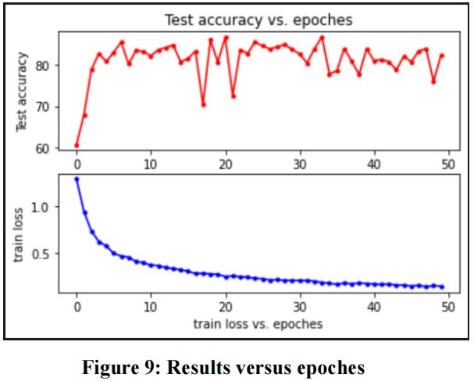
Results and Analysis
It takes approximately 1 minute and 40 seconds for each epoch to train the model
Highest training accuracy ： 86.81%
Average training accuracy： 82.31%
（1）test accuracy：
after nearly 5 epochs can the test accuracy converge to the average value
（2） train loss:
drops to less than 0.5 after 5 epochs
reaches a stable status after about 20 epochs

Slide 2
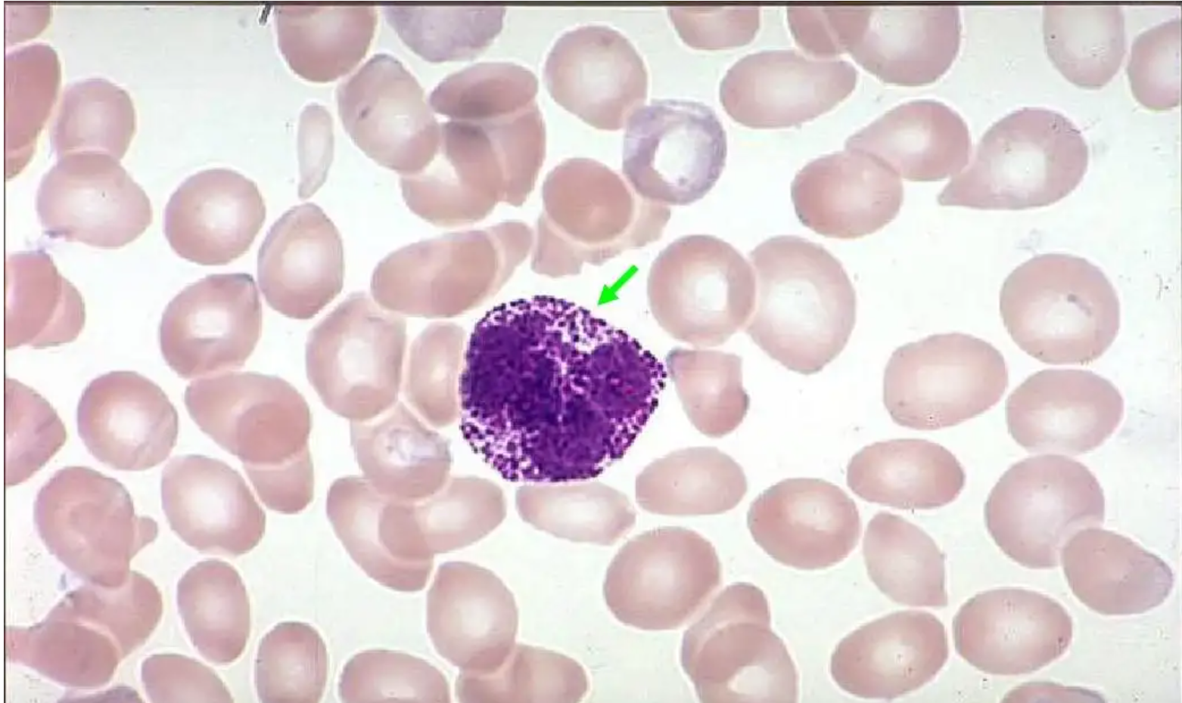
Discussion and Conclusion
For practical medical blood test, the dataset lacks of a
kind of white blood cell which is basophil. This leads to
decrease in value of the model.
In conclusion, the ResNet-50 model has enough ability to complete the classification task. It finally reaches an accuracy up to 86.8% with an average of 82.3%.The ResNet-50 model has satisfying potential and application value, also is worth to be optimized for future medical examination.

